Slide 1
The Behavior of Fluids

Slide 2

Blaise Pascal

Slide 3
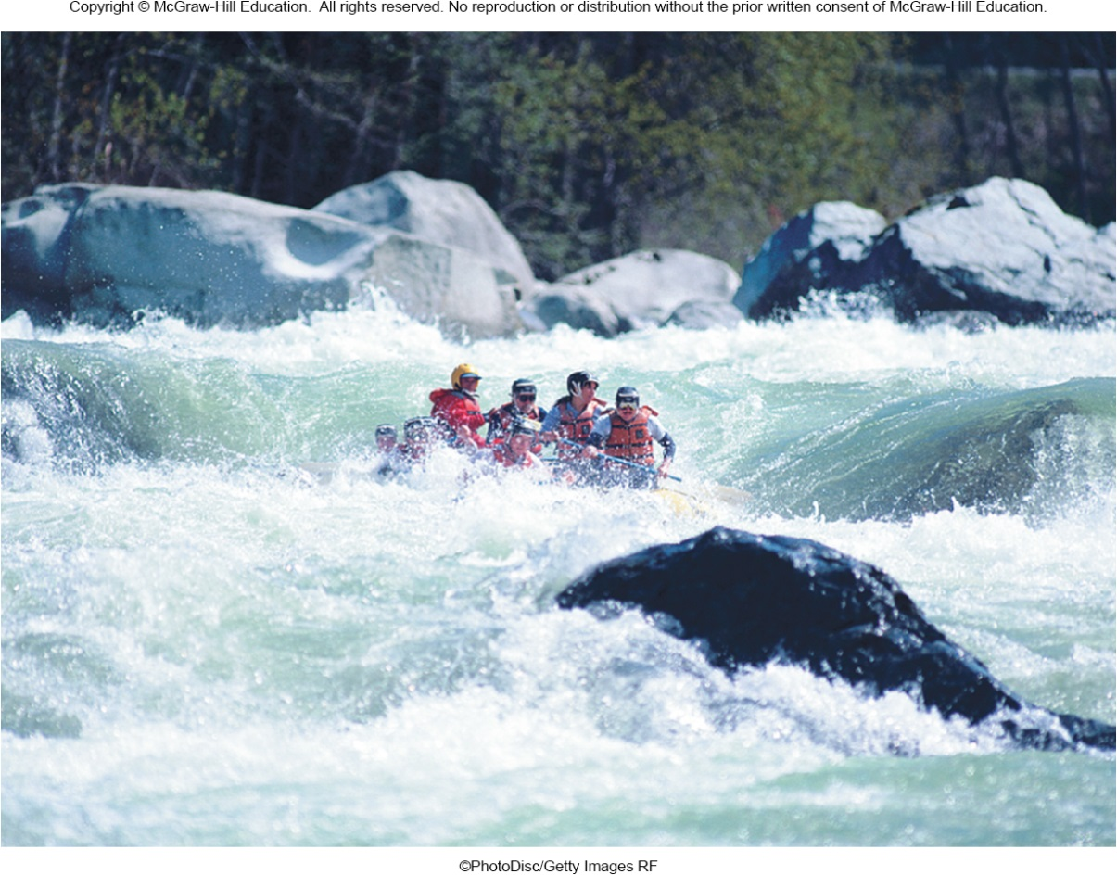
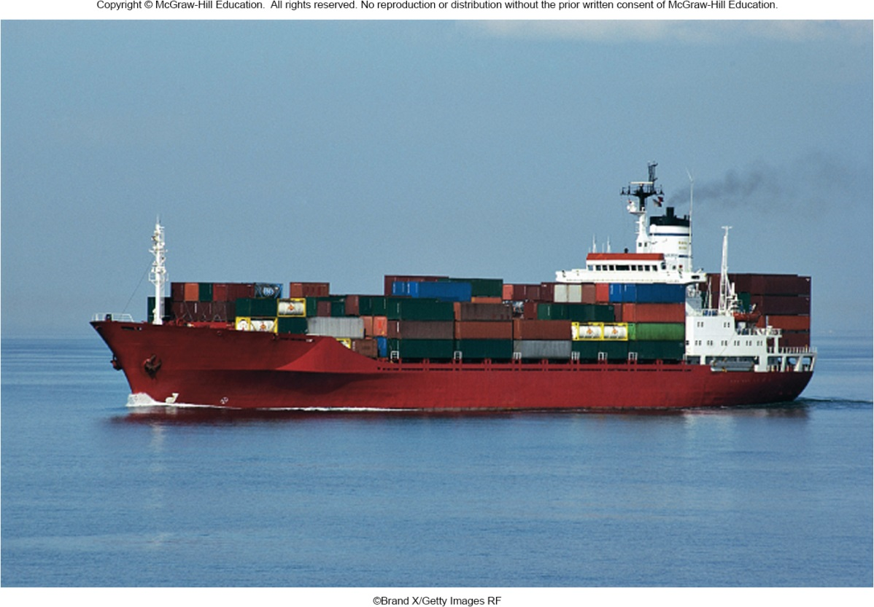
Pressure explains...
floating objects and moving fluids

Slide 4
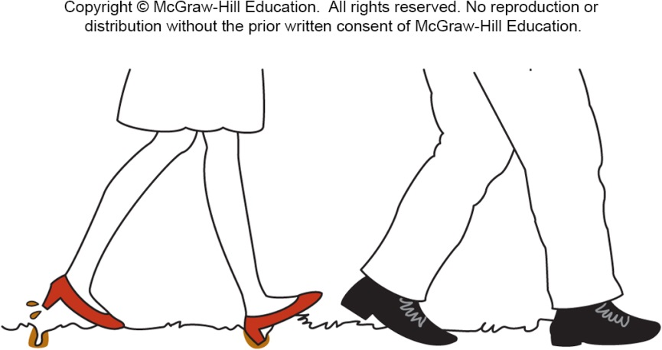
Pressure and Pascal’s Principle
Why does a smaller person wearing
high-heel shoes sink into soft ground more than a larger person wearing large shoes?

Slide 5
Pressure
The man weighs more, so he exerts a larger force on the ground.
The woman weighs less, but the force she exerts on the ground is spread over a much smaller area.
Pressure takes into account both force and the area over which the force is applied.
Pressure is the ratio of the force to the area over which it is applied:
Units: 1 N/m² = 1 Pa (pascal)
Pressure is the quantity that determines whether the soil will yield.

Slide 6
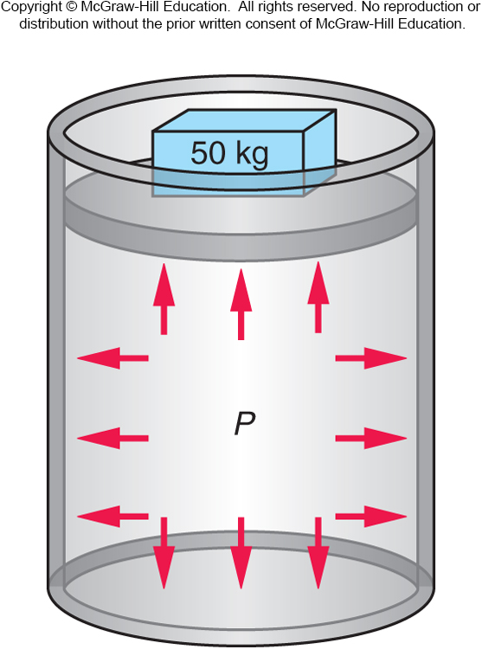
Pascal’s Principle
What happens inside a fluid when pressure is exerted on it?
Does pressure have a direction?
Does it transmit a force to the walls or bottom of a container?

Slide 7
Pascal’s Principle
Fluid pushes outward uniformly in all directions when compressed.
Any increase in pressure is transmitted uniformly throughout the fluid.
Pressure exerted on a piston extends uniformly throughout the fluid, causing it to push outward with equal force per unit area on the walls and the bottom of the cylinder.
This is the basis of Pascal’s Principle:
Any change in the pressure of a fluid is transmitted uniformly in all directions throughout the fluid.

Slide 8
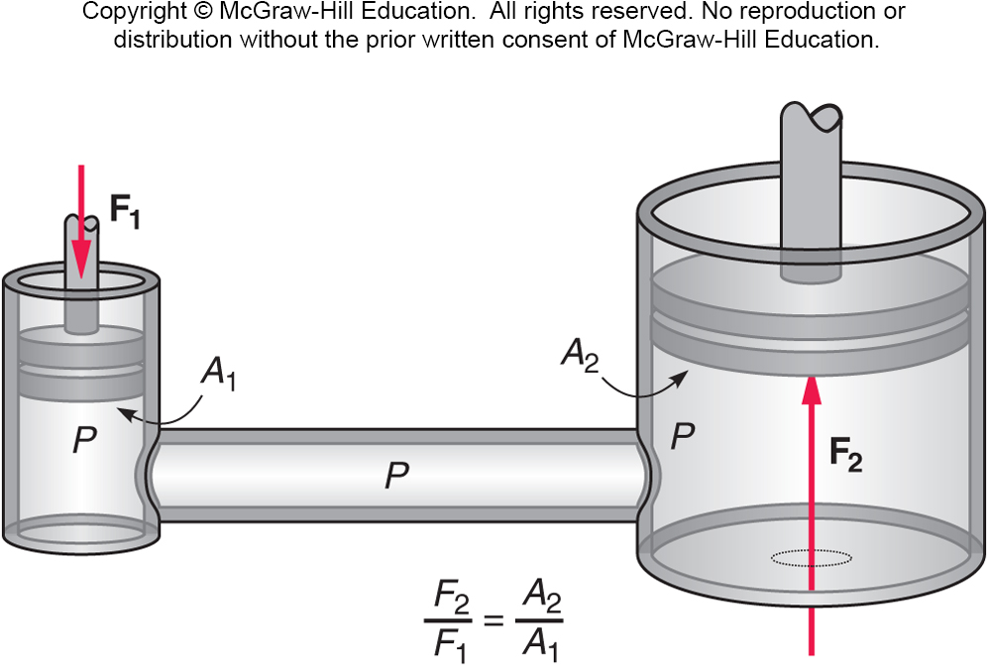
How does a hydraulic jack work?
A force applied to a piston with a small area can produce a large increase in pressure in the fluid because of the small area of the piston.
This increase in pressure is transmitted through the fluid to the piston with the larger area.
The force exerted on the larger piston is proportional to the area of the piston: F = PA.
Applying the same pressure to the larger area of the second piston results in a larger force on the second piston.

Slide 9
Atmospheric Pressure and the Behavior of Gases
Living on the surface of the earth, we are at the bottom of a sea of air.
This sea of air is thinner at higher altitudes.
It is also thinner during certain weather conditions.
We describe this property by atmospheric pressure: the pressure of the layer of air that surrounds the earth.
At sea level, the atmospheric pressure is 100 kPa, or 14.7 pounds per square inch, but it decreases with altitude.

Slide 10
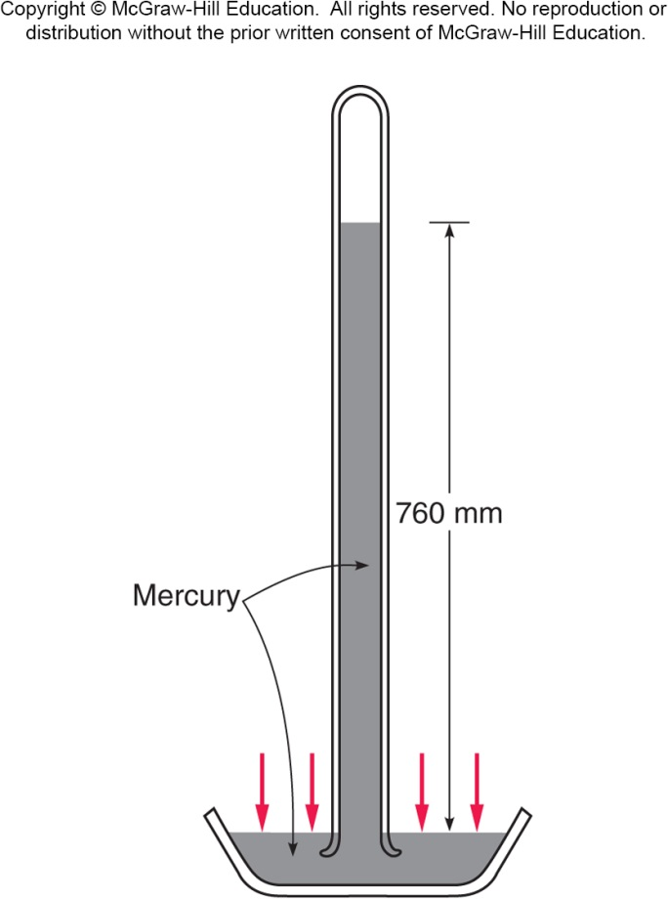
Torricelli invented the barometer, a device for measuring atmospheric pressure, in an attempt to explain why water pumps could pump water to a height of only 32 feet.
He filled a tube with mercury and inverted it into an open container of mercury.
Mercury worked well because it is much denser than water.
Density is the mass of an object divided by its volume.
Air pressure acting on the mercury in the dish supported a column of mercury, of height proportional to the atmospheric pressure.

Slide 11
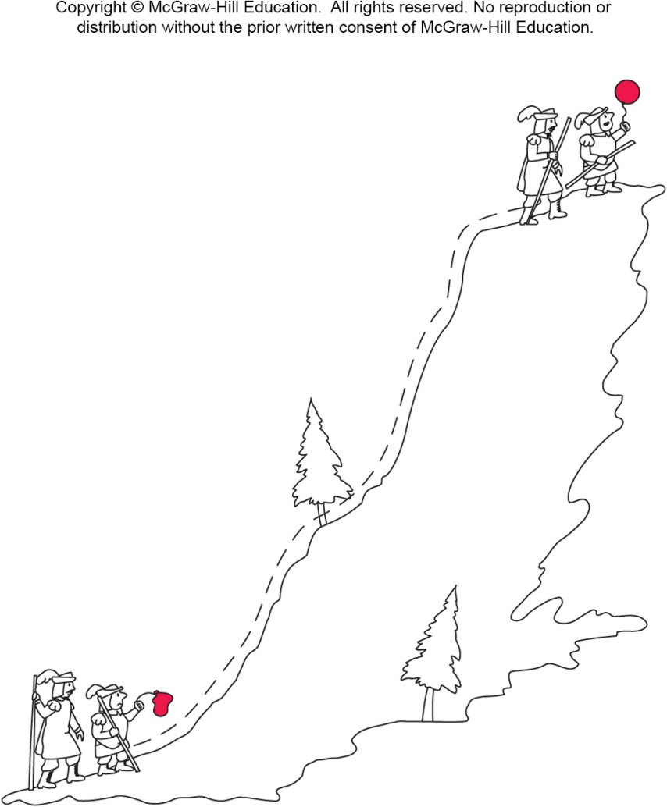
In other experiments on variations in atmospheric pressure, Pascal sent his brother-in-law to the top of a mountain with a barometer and a partially inflated balloon.
The balloon expanded as the climbers gained elevation.
This was evidence of a
decrease in the external
atmospheric pressure.

Slide 12
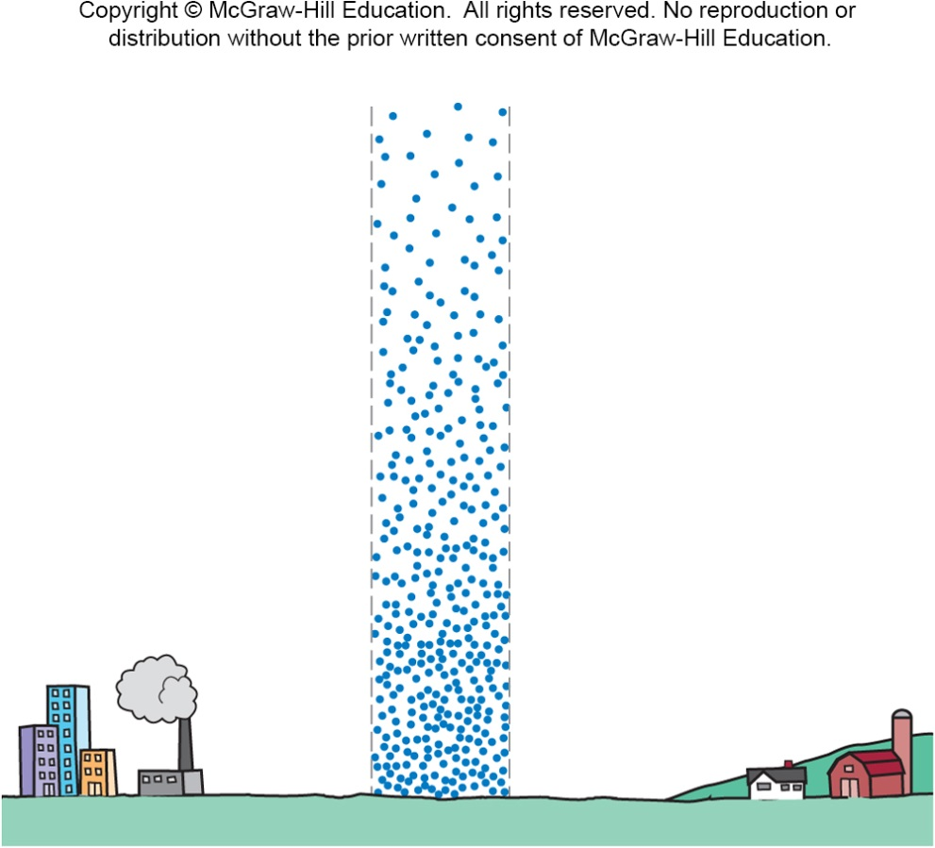
Boyle’s Law
Variations in the volume and density of a gas that accompanies changes in pressure were studied by Boyle and Mariotte.
The density of a column of air decreases as altitude increases because air expands as pressure decreases.

Slide 13
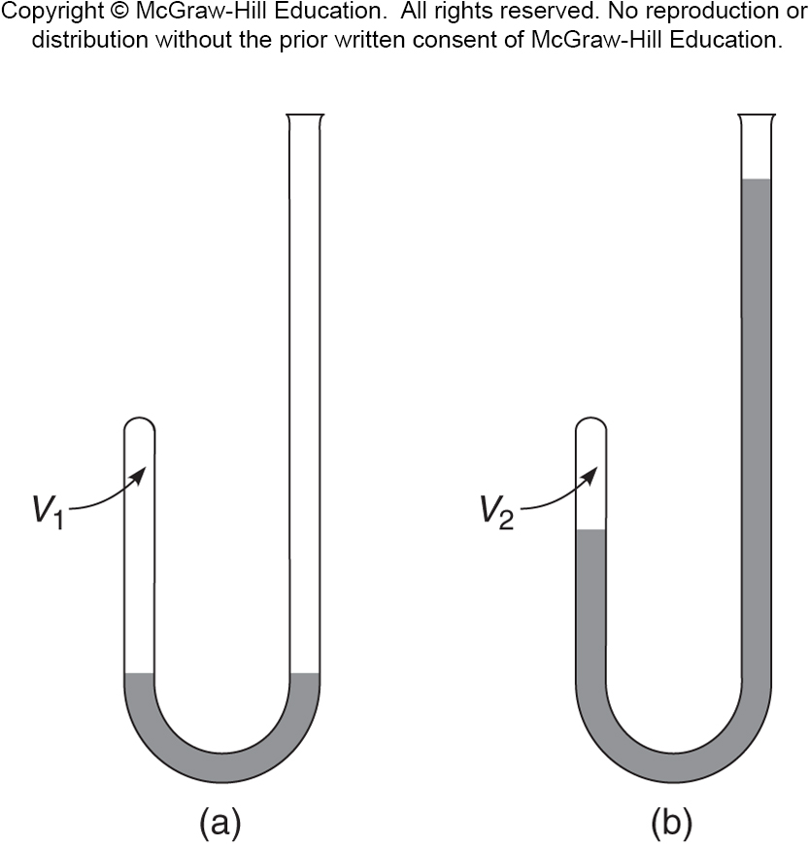
Boyle’s Law
Boyle discovered that the volume of a gas is inversely proportional to the pressure.
Boyle’s Law: PV = constant
If the pressure increases, the volume decreases.
The density of a column of air decreases as altitude increases because air expands as pressure decreases.
P₁V₁ = P₂V₂

Slide 14
A fixed quantity of gas is held in a cylinder capped at one end by a movable piston. The pressure of the gas is initially 1 atmosphere (101 kPa) and the volume is initially 0.3 m³. What is the final volume of the gas if the pressure is increased to 3 atmospheres at constant temperature?
P₁ = 1 atm P₂ = 3 atm
V₁ = 0.3 m³ V₂ = ?
V₂ = P₁V₁ / P₂
= (1 atm)(0.3 m³) / 3 atm
= 0.1 m³
0.1 m³
0.3 m³
1 m³
3 m³

Slide 15
Archimedes

Slide 16
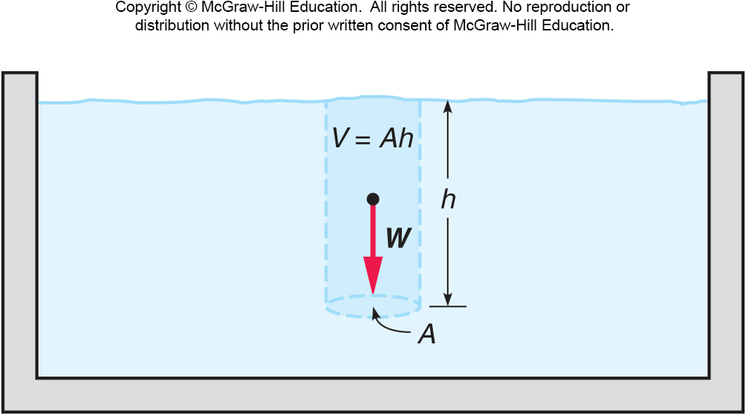
Archimedes’ Principle
The average density of an object compared to a fluid determines whether the object will sink or float in that liquid.
The upward force that pushes objects back toward the surface in liquids is called the buoyant force.
Archimedes’ Principle: The buoyant force acting on an object fully or partially submerged in a fluid is equal to the weight of the fluid displaced by the object.

Slide 17
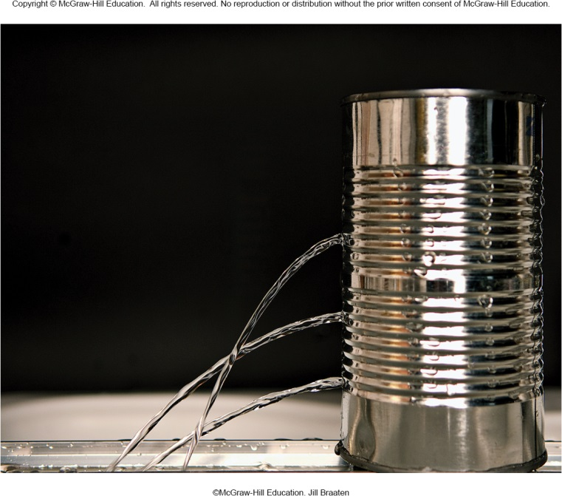
The source of the buoyant force is the increase in pressure that occurs with increasing depth in a fluid.
Atmospheric pressure is greater near the surface of the earth than at higher altitudes.
The pressure near the bottom of a pool is larger than near the surface.
The weight of the fluid above contributes to the pressure that we experience.
Water emerging from a hole near the bottom of a can filled with water has a larger horizontal velocity than water emerging from a hole near the top.

Slide 18
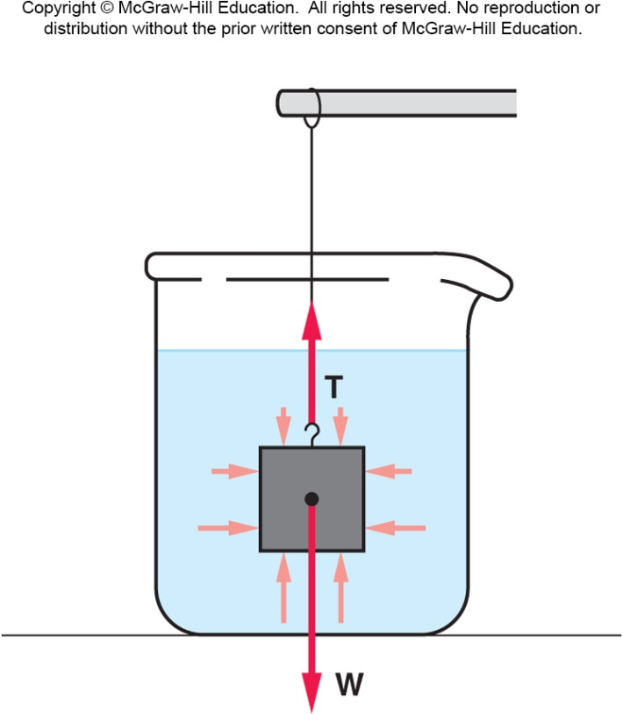
For example, consider a block submerged in water, suspended from a string.
The pressure of the water pushes on the block from all sides.
Because the pressure increases with depth, the pressure at the bottom of the block is greater than at the top.
There is a larger force (F = PA) pushing up at the bottom than there is pushing down at the top.
The difference between these two forces is the buoyant force.
The buoyant force is proportional to both the height and the cross-sectional area of the block, and thus to its volume.
The volume of the fluid displaced is directly related to the weight of the fluid displaced.

Slide 19
Fluids in Motion
The flow of a fluid is affected by many factors, including the viscosity of the fluid, a measure of the frictional effects within the fluid.
The larger the viscosity, the larger the frictional forces between different layers of the fluid.
Molasses has a larger viscosity than water.
Size also has an effect; for example, a stream’s current is faster where the stream is narrow.
Rate of flow, for example of water through a stream or pipe, is volume divided by time.
Gallons per minute; liters per second; cubic meters per second.

Slide 20
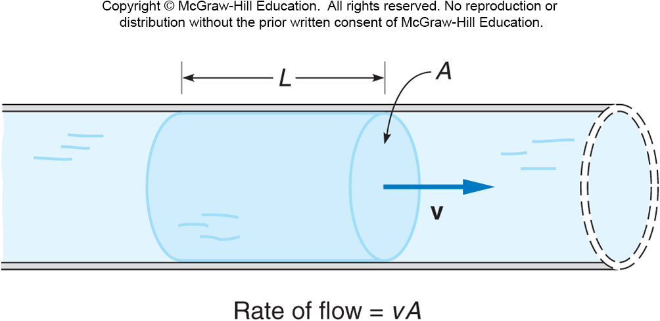
Fluids in Motion
The volume of a portion of water of length L flowing past some point in a pipe is the product of the length times the cross-sectional area A, or LA.
The rate at which water moves through the pipe is this volume divided by time: LA / t.
Since L / t = v, the rate of flow = vA.

Slide 21
If the flow is continuous, the rate of flow must be the same at any point along the pipe.
If the cross-sectional area A decreases, the speed v must increase to maintain the same rate of flow.

Slide 22
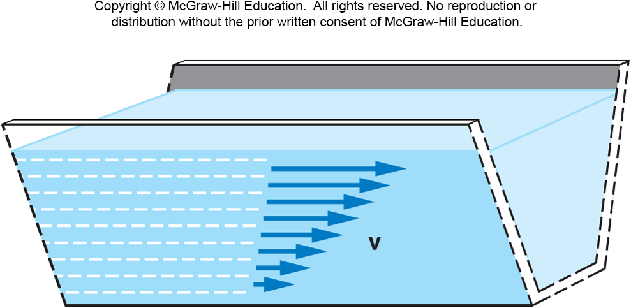
The speed will also usually be greatest near the middle of the stream or pipe.
The fluid can be imagined as flowing in layers.
Because of frictional or viscous forces, a thin layer that does not move is usually next to the walls of the pipe or trough.
The fluid speed increases as the distance from the wall increases.
Each layer moves more slowly than the one above.

Slide 23
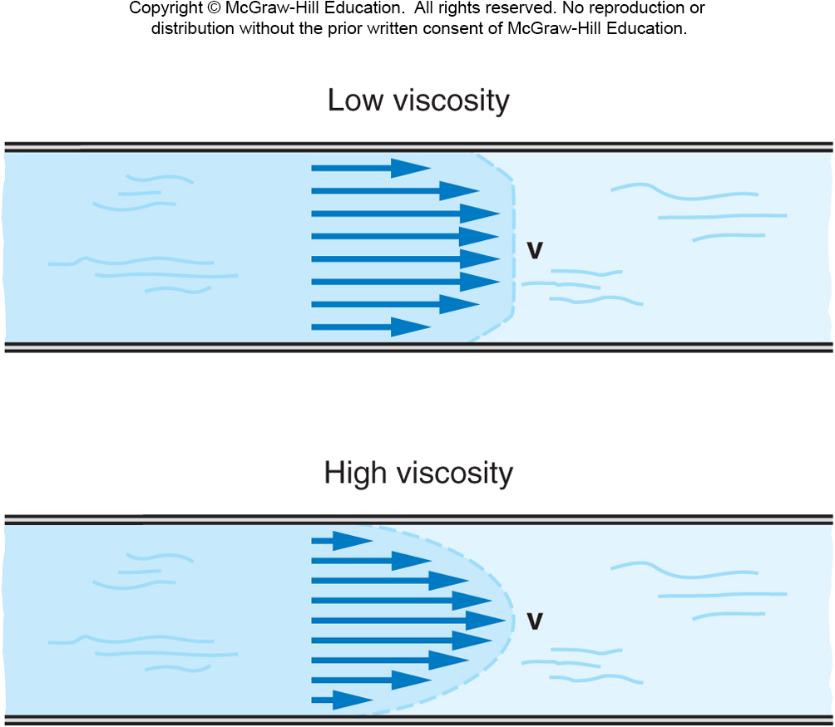
For a fluid with low viscosity, the transition to the maximum speed occurs over a short distance from the wall.
For a fluid with high viscosity, the transition takes place over a larger distance, and the speed may vary throughout the pipe or trough.

Slide 24
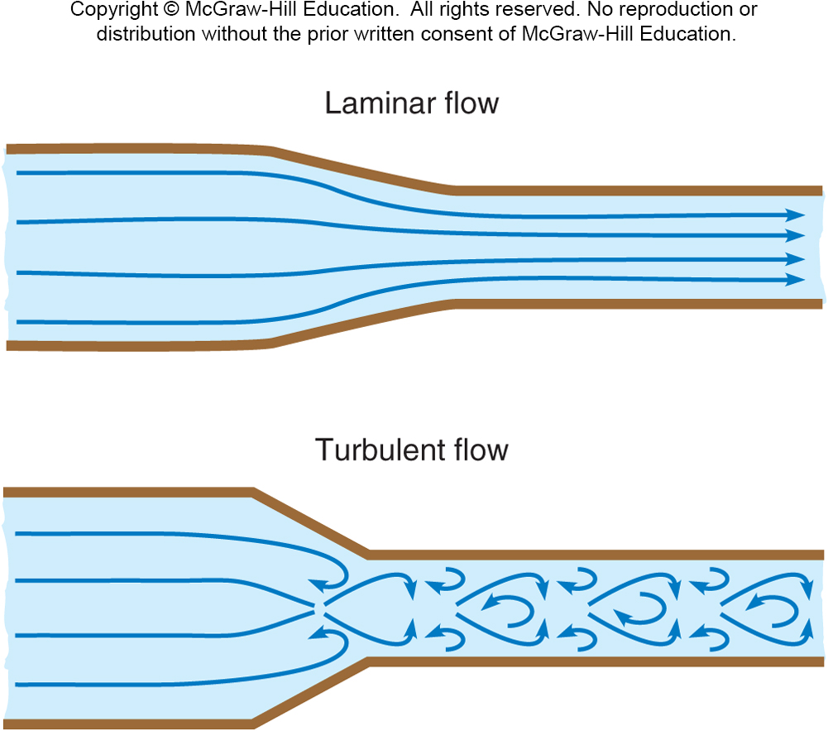
Laminar flow is smooth flow, with no eddies or other disturbances.
The streamlines are roughly parallel.
The speeds of different layers may vary, but one layer moves smoothly past another.
Turbulent flow does have eddies and whorls; the streamlines are no longer parallel.

Slide 25

Turbulent flow increases the fluid’s resistance to flowing through a pipe.
Higher speeds are more likely to exhibit turbulent flow.
Higher viscosities are less likely to exhibit turbulent flow.
Examples:
Narrowing of a stream
Water from a spigot
Smoke rising from a cigarette or candle.

Slide 26
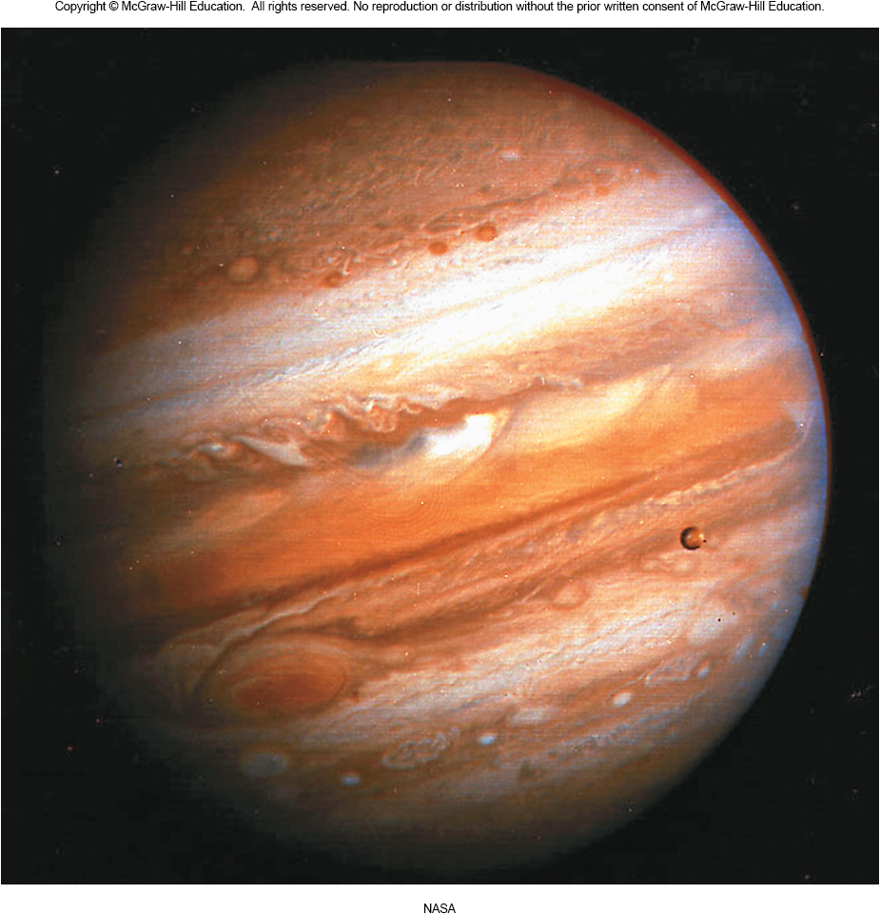
Huge example: the famous red spot of Jupiter
Whorls and eddies can be seen in the atmospheric gases.
The giant red spot is thought to be a giant and very stable atmospheric eddy.

Slide 27
Non-Newtonian Fluids

Slide 28
Bernoulli’s Principle
How does a large passenger jet manage to get off the ground?
What forces keep it in the air?
How is a ball suspended in mid-air by a leaf blower?
What happens if we do work on a fluid?
Bernoulli’s principle applies conservation of energy to the flow of fluids:
The sum of the pressure plus the
kinetic energy per unit volume of
a flowing fluid must remain constant.

Slide 29
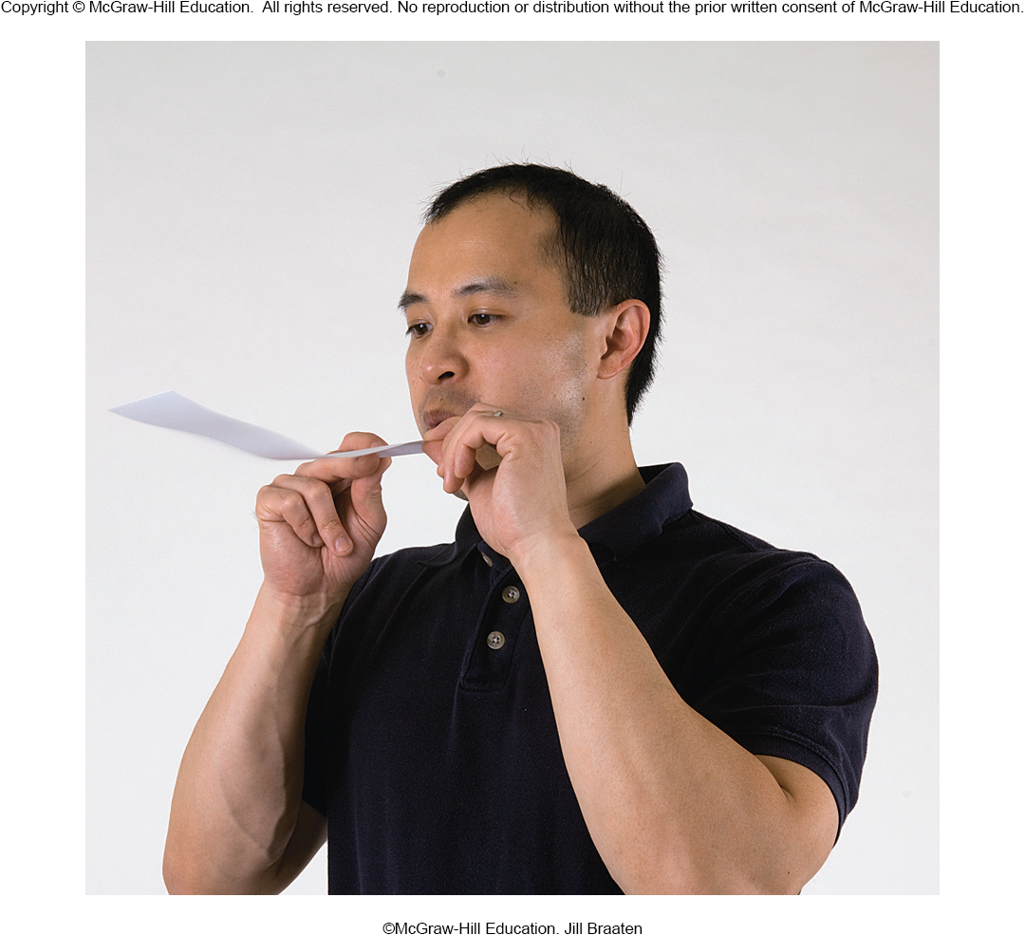
Pressure decreases with increasing speed.
Blowing across the top of a limp piece of paper causes the paper to rise, demonstrating Bernoulli’s principle.

Slide 30
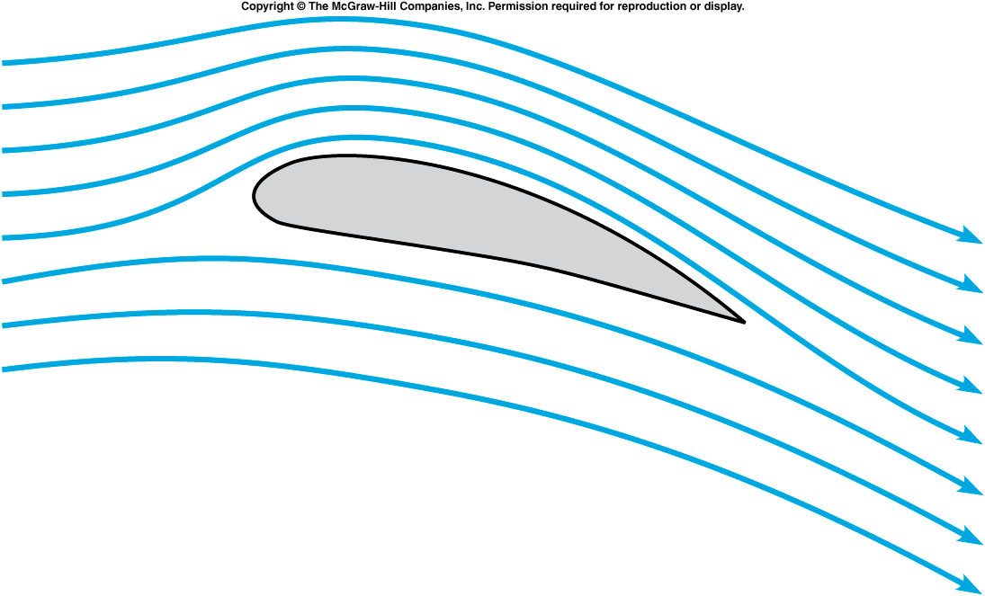
How does an airplane wing work?
The shape and tilt of the wing cause the air to move faster across the top than across the bottom.
This causes a lower pressure on the top of the wing.
The pressure difference produces a net upward force, or lift, acting on the wing.
When the lift balances the airplane’s weight, the airplane will fly.

Slide 31
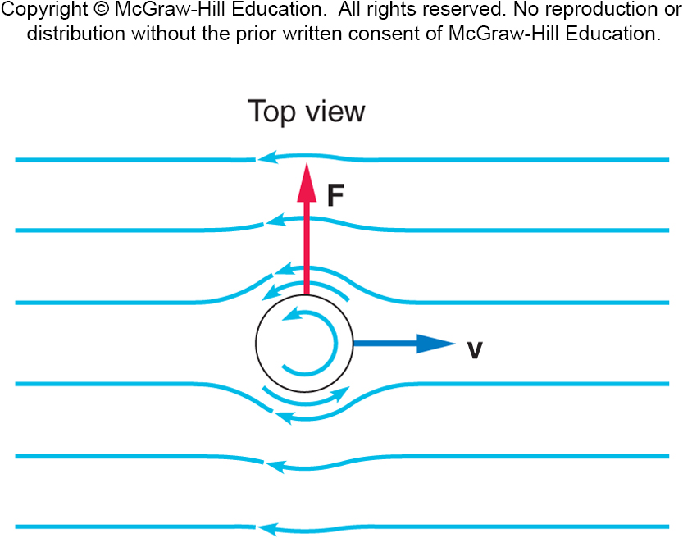
Why does a curveball curve?
The whirlpool of air created by the spin of the ball causes the air to move more rapidly on one side than the other. The difference in pressure produces a force toward the lower-pressure, higher-airspeed side.

